Slide 1
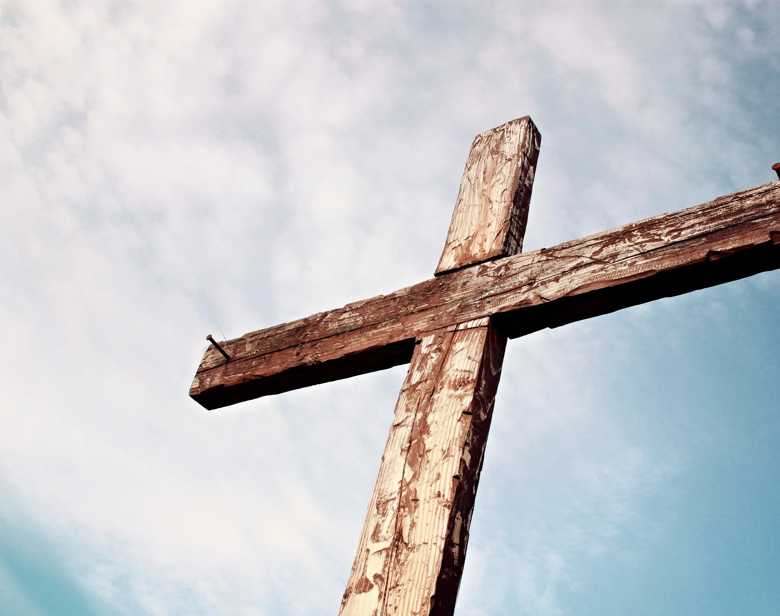
Old Rugged Cross

Slide 2
G
On a hill far away
C
stood an old rugged cross,
D G
The emblem of suff’ring and shame,

Slide 3
G
And I love that old cross
C
where the Dearest and Best
D C G
For a world of lost sinners was slain.

Slide 4
D G
So I’ll cherish the old rugged cross
C G
Till my trophies at last I lay down
G C
I will cling to the old rugged cross
G D G
And exchange it some day for a crown

Slide 5
G
Oh, that old rugged cross,
C
so despised by the world
D G
Has a wondrous attraction for me

Slide 6
G
For the dear Lamb of God
C
left His glory above
D C G
To bear it to dark Calvary

Slide 7
D G
So I’ll cherish the old rugged cross
C G
Till my trophies at last I lay down
G C
I will cling to the old rugged cross
G D G
And exchange it some day for a crown

Slide 8
G
In the old rugged cross,
C
stained with blood so divine,
D G
A wondrous beauty I see;

Slide 9
G
For ’twas on that old cross
C
Jesus suffered and died,
D C G
To pardon and sanctify me

Slide 10
D G
So I’ll cherish the old rugged cross
C G
Till my trophies at last I lay down
G C
I will cling to the old rugged cross
G D G
And exchange it some day for a crown

